Slide 1

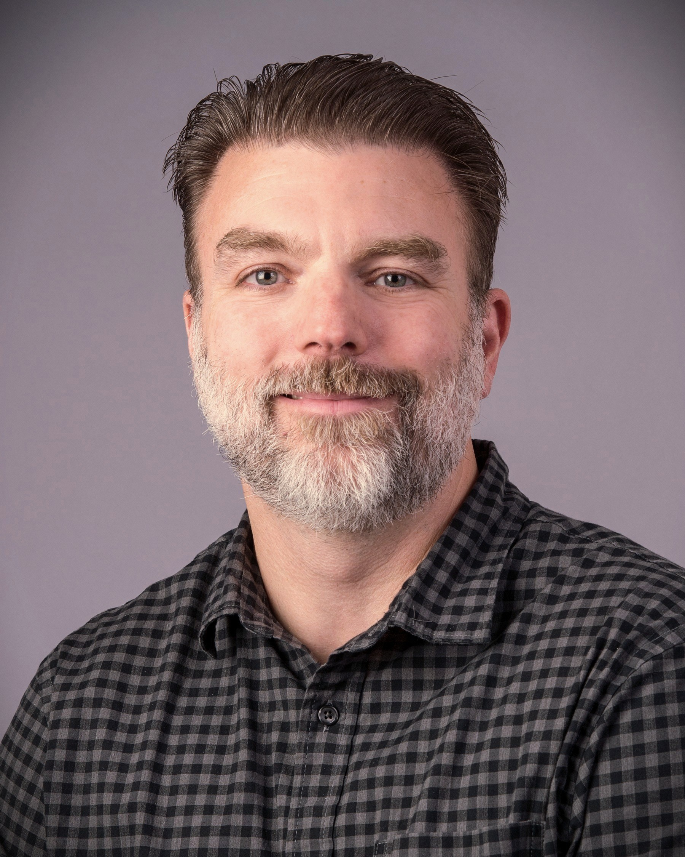
SIPES July 15, 2026 MEETING & LUNCHEON
7/15/26, 11:30 AM, Bush Convention Center
Visitor Price: $35 at the Door ($45 without RSVP) [check or cash only]
RSVP by 7/10/26 to George@pemidland.com
“Investigating the Role of Geological Architecture on Shallow Injection in the Delaware Basin through Field Studies and Finite Element Modeling”
Seth Busetti: University of Texas at the Bureau of Economic Geology
ABSTRACT:
Active disposal of produced water into shallow intervals in the Delaware Basin has been linked to surface uplift and instances of lost fluid containment due to injection capacity limits. With produced water and disposal rates expected to remain high, understanding the relationship between geology and adverse events is critical. This presentation focuses on investigating how geological fabric in the Delaware Mountain Group injection zone affects fluid migration during injection. Structural and stratigraphic data from well logs, 3D seismic, and analog outcrops inform flow parameters used in both conventional reservoir simulations and new geomechanically coupled finite element models. Data suggests moderate flow anisotropy where structureless and often amalgamated sandstone are bounded by erosional surfaces with expected decreasing vertical to horizontal permeability ratios in overlying planar-laminated sandstone and siltstone containing dispersed organic matter. Interspersed well-cemented sandstone beds mark discrete zones with porosity and permeability reduction. However, enhanced flow is anticipated in more brittle sandstone beds with elevated open natural fracture intensity especially where fractures experience dynamic reactivation following seismic events.
BIOGRAPHY:
Seth Busetti is a Research Associate Professor in the Jackson School of Geosciences, University of Texas at Austin, working with the Center for Injection and Seismicity Research at the Bureau of Economic Geology. His research focuses on the integration of structural geology, geomechanics, reservoir characterization, and industry operations. He earned a PhD and MS degree from the University of Oklahoma and a BS from the Colorado School of Mines. Prior to joining BEG, he worked in industry in various R&D and technology roles.

